Slide 1
Event-oriented Data Aggregation for WSN 3
- Solution Design (Simple Version)

Slide 2
Event Relationships
Relationships of child / parent events:
  Attributes used in the filter
  Attributes used in the aggregated function
Types of relationships (child -> parent)
  Static -> dynamic
  Dynamic -> static
  Equal -> equal

Slide 3
Basic Idea
Different attributes have different ‘time-to-live’ (lease):
  Static -> dynamic: set up a structure for the nodes which are responsible for getting the static attribute.
  Dynamic -> static: Nodes can ‘learn’ the forwarding path.

Slide 4
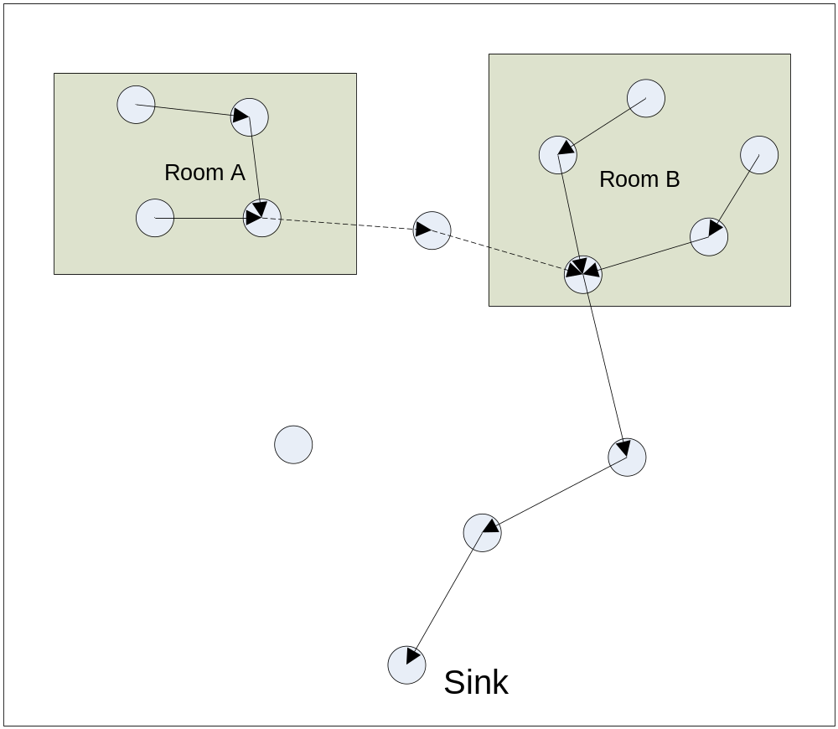
Basic Idea (Static -> Dynamic)

Slide 5
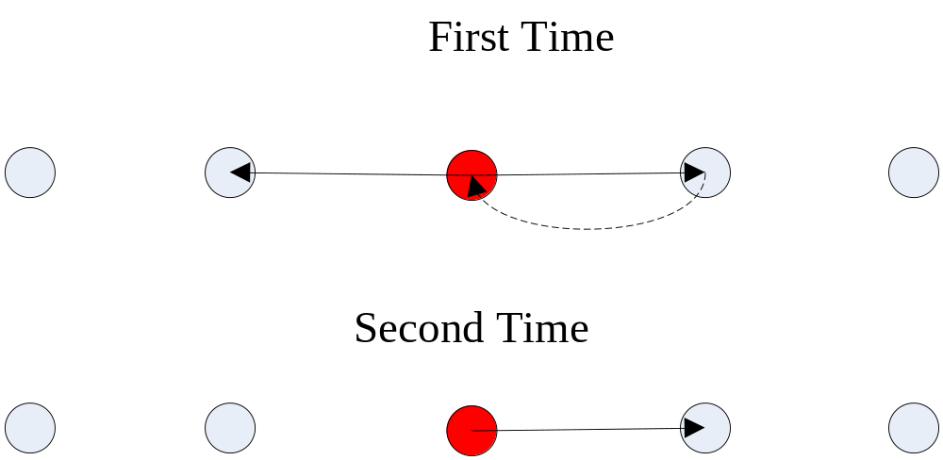
Basic Idea (Dynamic -> Static)

